Slide 1


UNIT 4: So much to do, so little time
Self-check 4

Slide 2
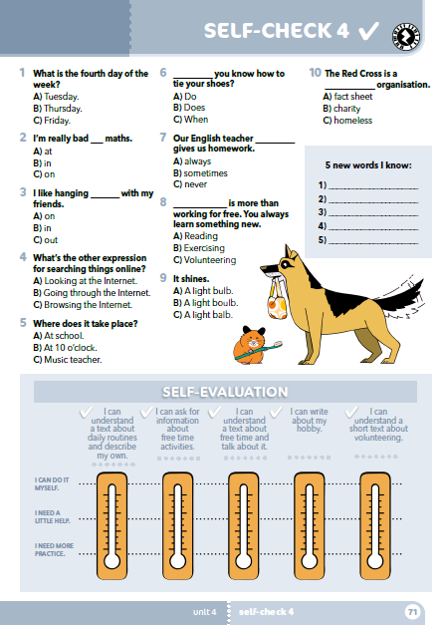
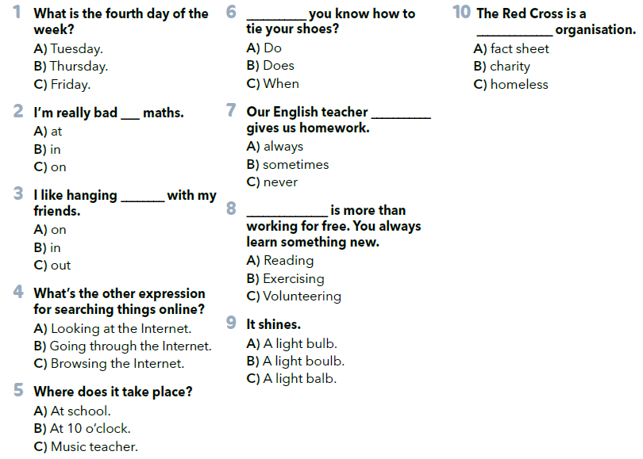
Circle the correct answer.

Slide 3
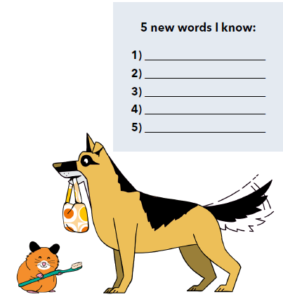

Slide 4
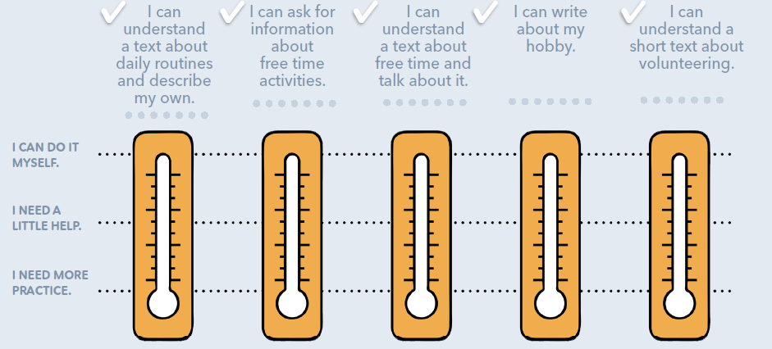
Procijeni vlastito znanje uz listu za samoprocjenu:
Znam postaviti pitanje u vezi slobodnih aktivnosti.
Mogu razumjeti tekst o dnevnim rutinama i opisati svoju dnevnu rutinu
Mogu razumjeti tekst o slobodnom vremenu i pričati o tome.
Mogu razumjeti kratak tekst o volontiranju.
Znam opisati svoj hobi.
Mogu to samostalno učiniti.
Potrebna mi je manja pomoć.
Trebam to dodatno uvježbati.

Slide 5
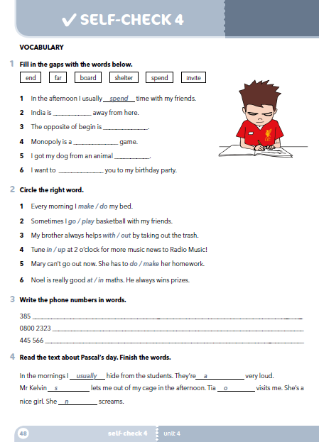
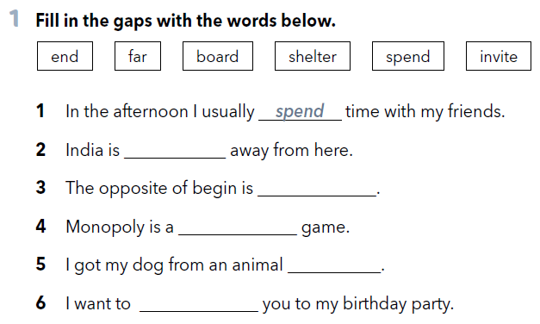
Workbook p 48.
far
end
board
shelter
invite

Slide 6
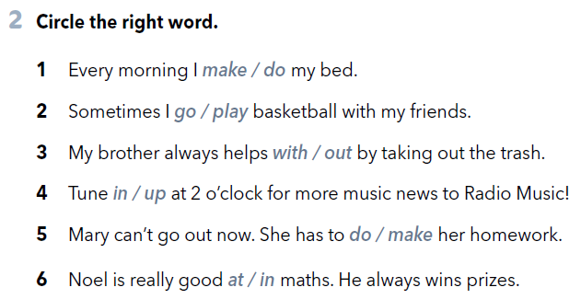

Slide 7
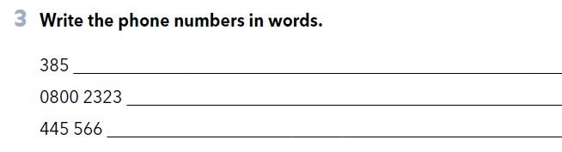
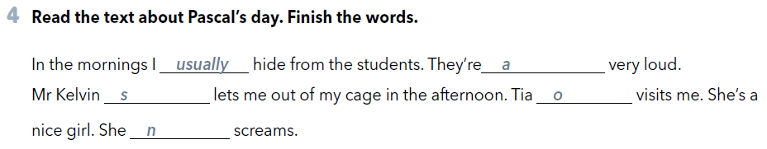
three eight five
oh eight double oh two three two three
double four double five double six
lways
ometimes
ften
ever

Slide 8
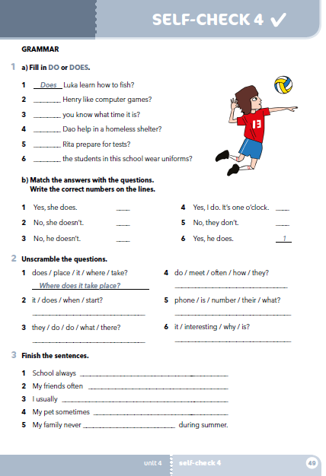
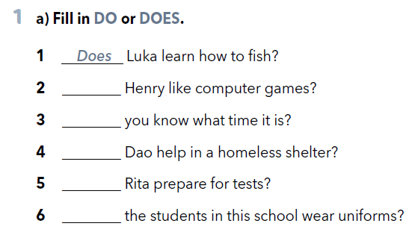
workbook p 49.
Does
Do
Does
Does
Do

Slide 9
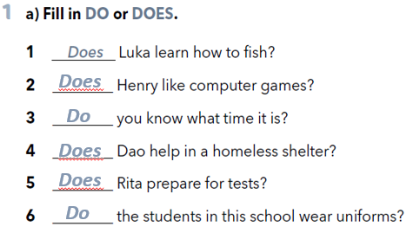
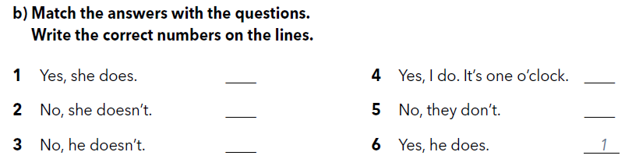
5
3
4
6
2

Slide 10
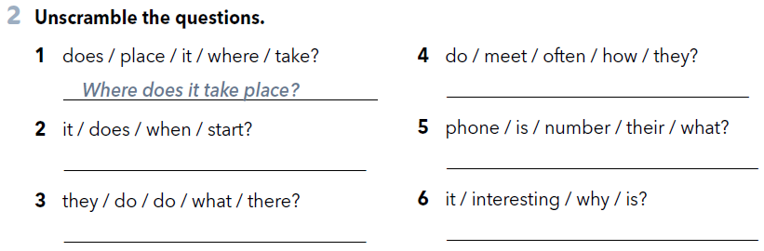
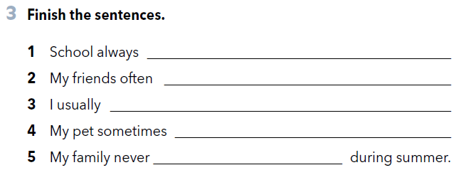
How often do they meet?
When does it start?
What is their phone number?
What do they do there?
Why is it interesting?

Slide 11

Check your knowledge
https://www.e-sfera.hr/dodatni-digitalni-sadrzaji/10ddcfad-ebd0-4cb8-9edf-e0c2edc63e84/

